Slide 1

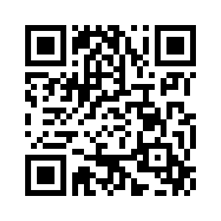

Kivy Workshop 1
Join our
Telegram Chat!
Introduction | .py & .kv | Class
Basic Structure | Layouts | Widgets
Interaction: id/functions
Build A Calculator | User Login Page
Instructor: Li Yuxuan

Slide 2
Download materials here!
https://goo.gl/7ZdQPV

Slide 3
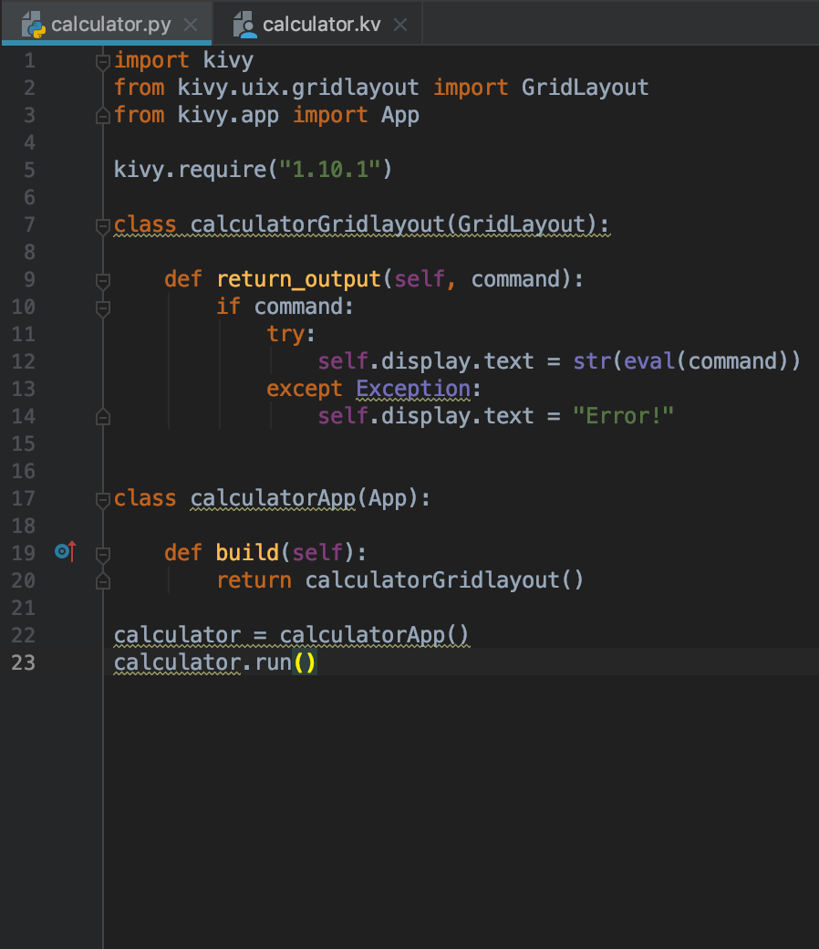
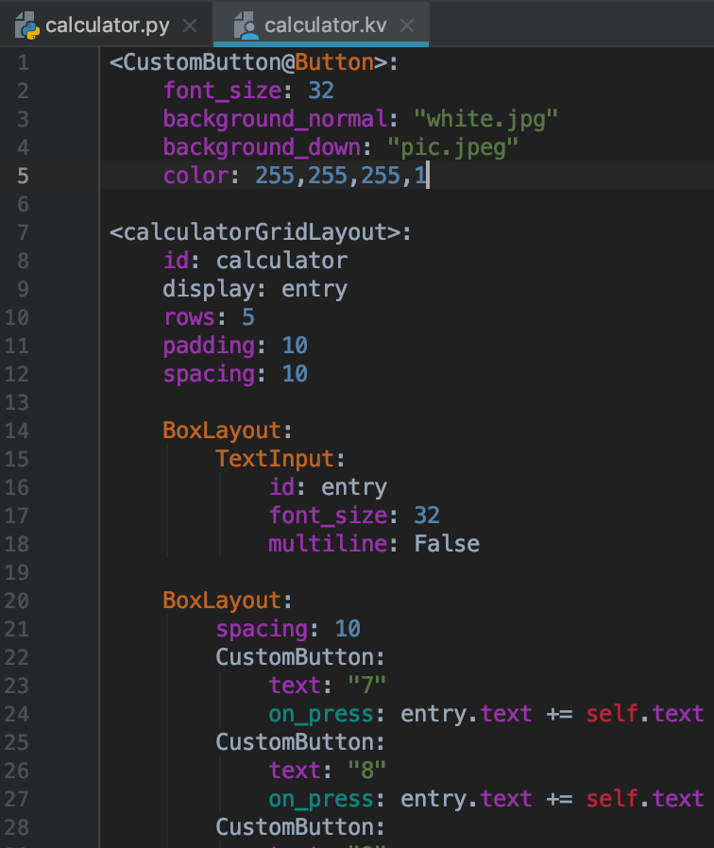
Introduction
main.py
main.kv
Notes:
https://kivy.org/doc/stable/gettingstarted/intro.html https://kivy.org/doc/stable/guide/basic.html

Slide 4
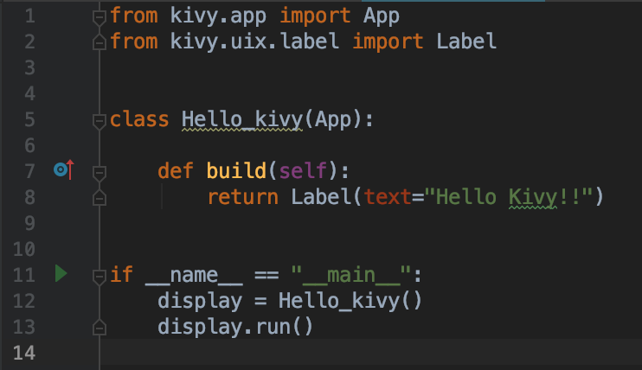
First Kivy App
firstapp.py

Slide 5

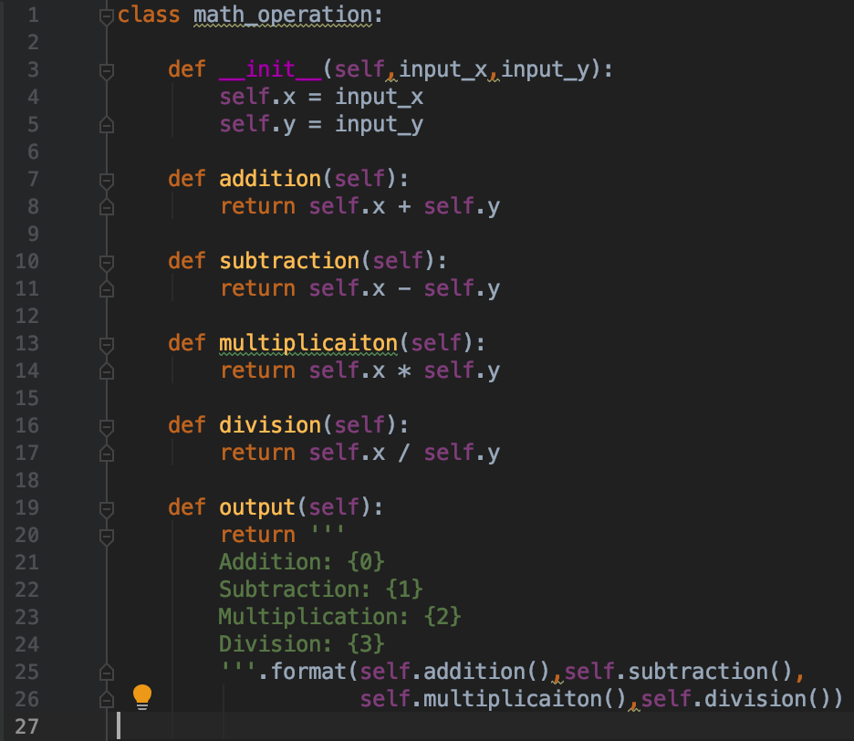

Class
temp.py
x: 0
y: 0
addition()
subtraction()
multiplication()
division()
math_operation

Slide 6
class math_operation:
def __init__(self, arg1, arg2):
math_operation(10,20)
Notes:
__init__: initialise class object with given arguments
self: literally “self”, pointing to the class itself
Other functions take the argument of the class itself

Slide 7
Referencing: Try this out!
firstapp_reference_practice.py
firstapp.py
temp.py
In your “firstapp.py” file, try to import the class you created in “temp.py”. Change your kivy display output to what your class object will output. You can input any number (x,y) you want.

Slide 8
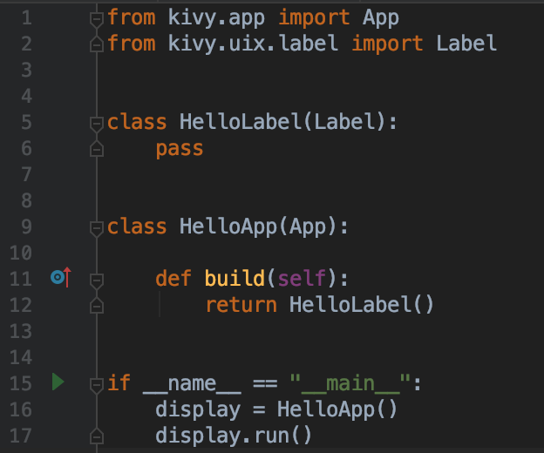
Basic Structure: python file
Try this: text = math_operation.__name__
hellokivy.py
Name must be the same as your .kv file name!
Notes:
HelloLabel inherits the object Label
HelloApp is our app object that will be built and run later

Slide 9
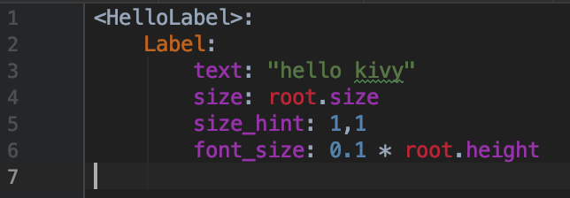
Basic Structure: kivy file
class
Object the class holds
Parameters to define the object
Hello.kv

Slide 10
Layouts
xxxxxxxxxxxxxxxxxxxxxxxxxxxxxxxxxxxxxxxx

Slide 11
Boxlayout
boxlayout.py
boxlayout.kv
Notes:
The StackLayout arranges children vertically or horizontally, as many as the layout can fit. The size of the individual children widgets do not have to be uniform.

Slide 12
padding: 20
orientation: “vertical”
spacing: 20

Slide 13
Try it out: create the following display
box_activity.py
box_activity.kv
Notes:
The StackLayout arranges children vertically or horizontally, as many as the layout can fit. The size of the individual children widgets do not have to be uniform.

Slide 14
Floatlayout
floatlayout.py
floatlayout.kv
Notes:
The StackLayout arranges children vertically or horizontally, as many as the layout can fit. The size of the individual children widgets do not have to be uniform.

Slide 15
size_hint: 0.5,0.5
pos_hint: {“top”:1 ,”right”:1 }

Slide 16
Try it out: create the following display
float_activity.py
float_activity.kv
Notes:
The StackLayout arranges children vertically or horizontally, as many as the layout can fit. The size of the individual children widgets do not have to be uniform.

Slide 17
Gridlayout:
gridlayout.py
gridlayout.kv
Notes:
The StackLayout arranges children vertically or horizontally, as many as the layout can fit. The size of the individual children widgets do not have to be uniform.

Slide 18
Try it out: create the following display
grid_activity.py
grid_activity.kv
Notes:
The StackLayout arranges children vertically or horizontally, as many as the layout can fit. The size of the individual children widgets do not have to be uniform.

Slide 19
Stacklayout
stacklayout.py
stacklayout.kv
Notes:
The StackLayout arranges children vertically or horizontally, as many as the layout can fit. The size of the individual children widgets do not have to be uniform.

Slide 20
Try it out: create the following display
stack_activity.py
stack_activity.kv
Notes:
The StackLayout arranges children vertically or horizontally, as many as the layout can fit. The size of the individual children widgets do not have to be uniform.

Slide 21
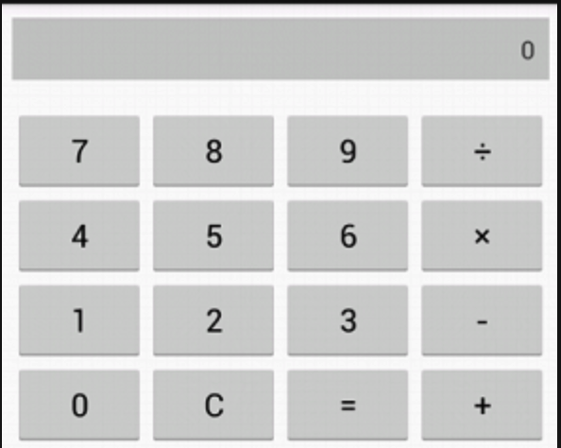
Challenge!
Create a standard calculator layout
calculator_activity.py
calculator_activity.kv
calculator.py
calculator.kv
Hint:
You should use both .py and .kv files
You should use a mixture of layouts and sub-layouts inside parent-layout
You should use button as the widgets
For the display panel, you can use button widget first, alignment of the text is not required

Slide 22
Challenge!
Create your login page layout!
login.py
login.kv
x
Hint:
You should use both .py and .kv files
You should use a mixture of layouts and sub-layouts inside parent-layout
You should use button as the widgets
For text input, you can use button with text to represent first.
avocado
******
Login

Slide 23
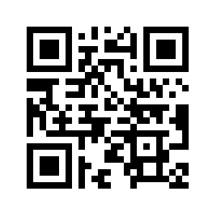
THANK YOU!
Please do the short survey to help us improve :)
https://goo.gl/xNp2Fn

Slide 24

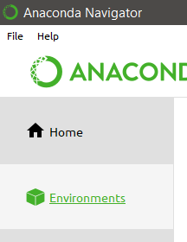
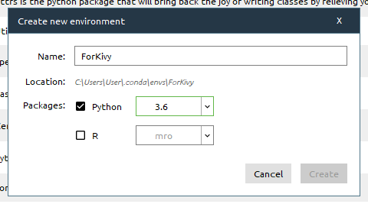
Installing kivy on Anaconda

Slide 25
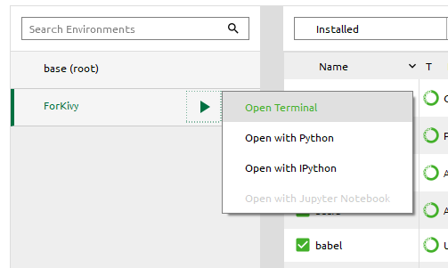
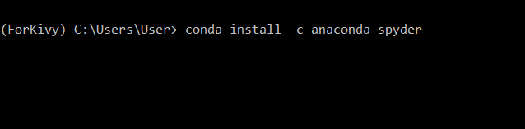
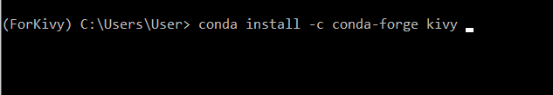
1
2

